Slide 1


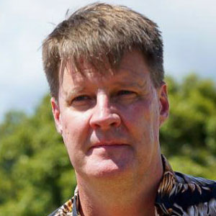

Roundtable introduction
WELCOME!
@EcoCommonsAus
Species Distribution Modelling in R
Step 1: Occurrence data
Dr Rob Clemens (he/him)
Change & Communications E: comms@ecocommons.org.au
T: @EcoCommonsAus
@RobertSClemens1
Notes:
Welcome to the workshop: Using the BCCVL to solve environmental problems, brought to you by the EcoCommons program
Firstly, as we gather for this workshop dispersed across many physical locations, I would like to take a moment to acknowledge the various traditional owners of the lands on which we meet, including the the Traditional Custodians of the ACT, the Ngunnawal people where I am today. I acknowledge the Elders – past, present and emerging of all the lands that we work and live on, and recognise their extraordinary contributions to the cultural, economic and scientific domains that we will discuss today.

Slide 2











Vision: Australian practitioners and researchers to use trusted, world-leading ecological and environmental modelling tools to protect and restore the planet.
Mission: To be the platform of choice to analyse and model ecological and environmental challenges.
EcoCommons received investment from the Australian Research Data Commons (ARDC). The ARDC is funded by the National Collaborative Research Infrastructure Strategy (NCRIS).
Notes:
The EcoCommons is a partnerships program between 9 partner organisations.
We are building: A trusted single platform for ecological and environmental modelling & analysis - our mission is to build the platform of choice for environmental problem solving. The program will run for at least 3 years, so that’s between 2020 and 2023.
As we are building EcoCommons to become a National Research Infrastructure, our vision is to empower Australian practitioners and researchers to use trusted, world-leading ecological and environmental modelling tools.

Slide 3
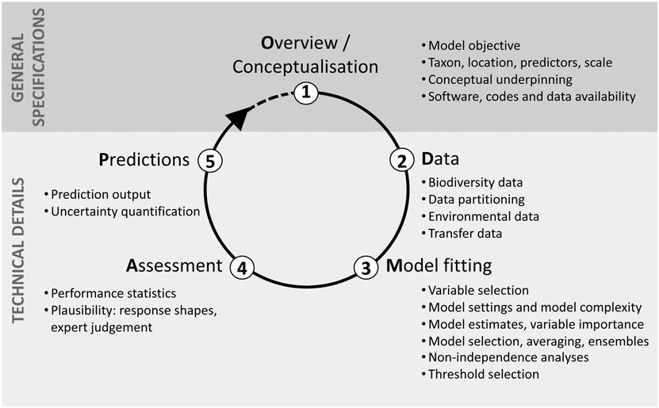
Overview of the process
Zurell, et. al.(2020), A standard protocol for reporting species distribution models. Ecography, 43: 1261-1277. https://doi.org/10.1111/ecog.04960

Slide 4
Does available data match your question?
Systematic sampling with same method in each locations, a well defined sampling protocol and zeros are recorded when a species is not detected.
Structured monitoring where zeros and sampling effort can be inferred
Unstructured monitoring where zeros and possibly sampling effort can be inferred
Opportunistic data where method and sampling are largely unknown
Best
Worst

Slide 5
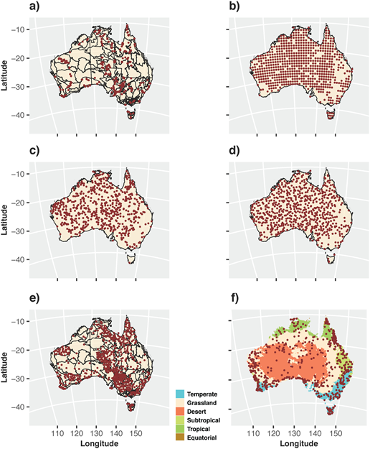
Geographic space
Guerin, G. R., Williams, K. J., Sparrow, B., & Lowe, A. J. (2020). Stocktaking the environmental coverage of a continental ecosystem observation network. Ecosphere, 11(12), e03307.
Temporal agreement between occurrence records and environmental predictors

Slide 6
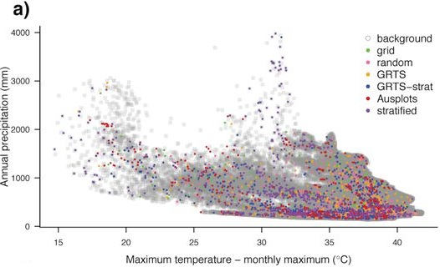
Environmental space
Guerin, G. R., Williams, K. J., Sparrow, B., & Lowe, A. J. (2020). Stocktaking the environmental coverage of a continental ecosystem observation network. Ecosphere, 11(12), e03307.
Notes:
However, if you look up a distribution map of a species, it often shows a range rather than dots on a map. So, how do we go from specific places where individuals of a species have been observed to producing a map that gives an estimate of the distribution of that species? This is where species distribution models come into play.

Slide 7
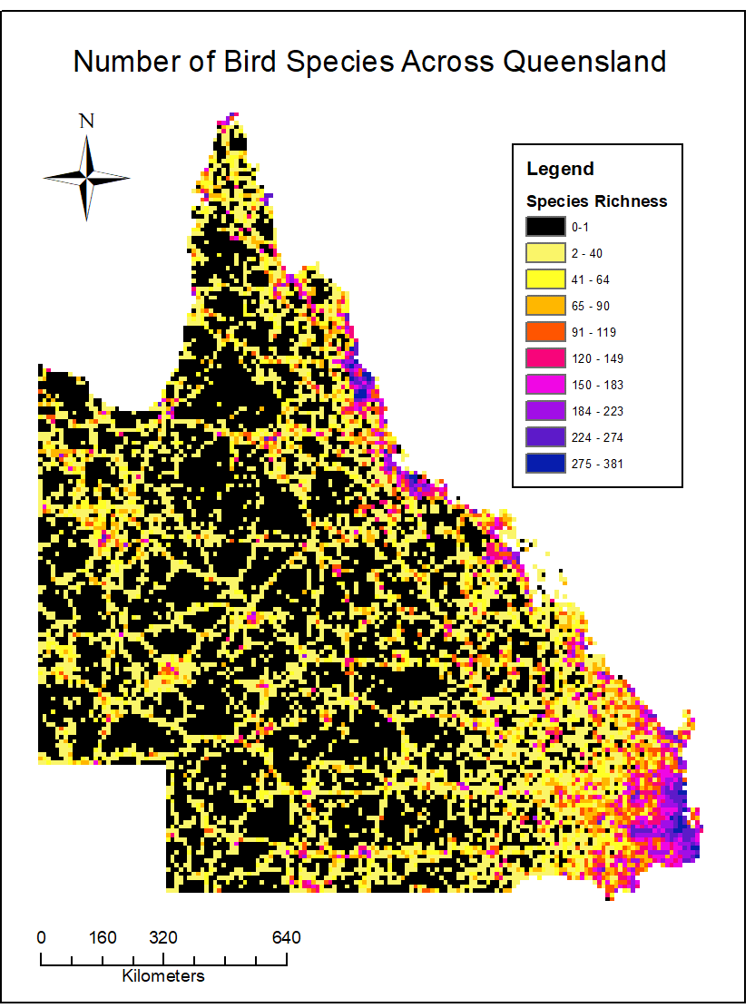
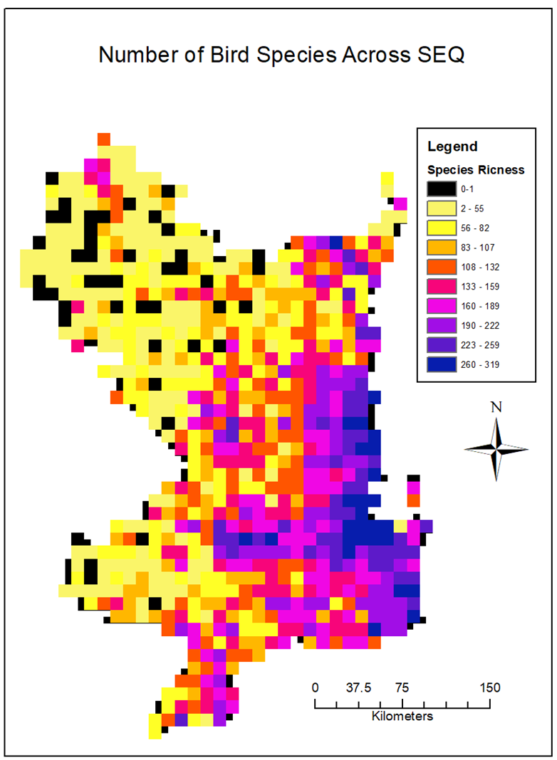
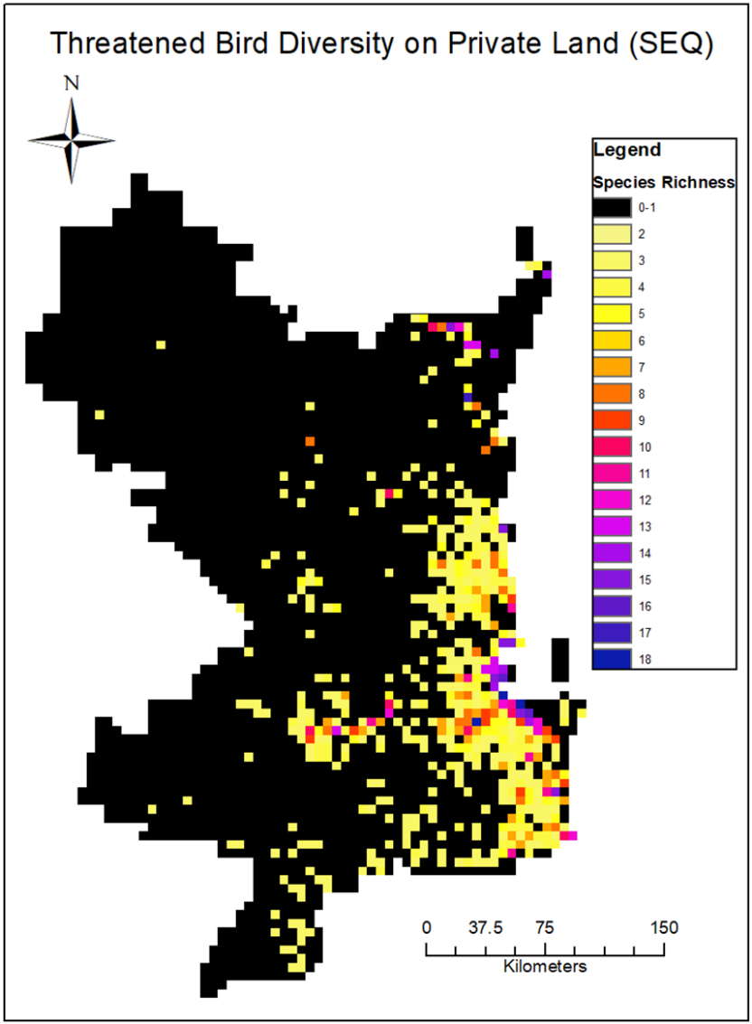
Sampling bias
Notes:
However, if you look up a distribution map of a species, it often shows a range rather than dots on a map. So, how do we go from specific places where individuals of a species have been observed to producing a map that gives an estimate of the distribution of that species? This is where species distribution models come into play.

Slide 8
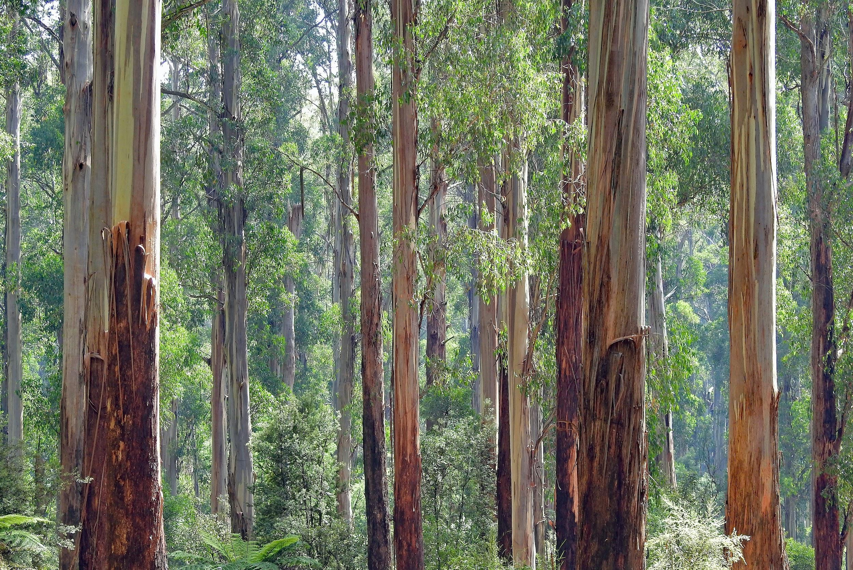
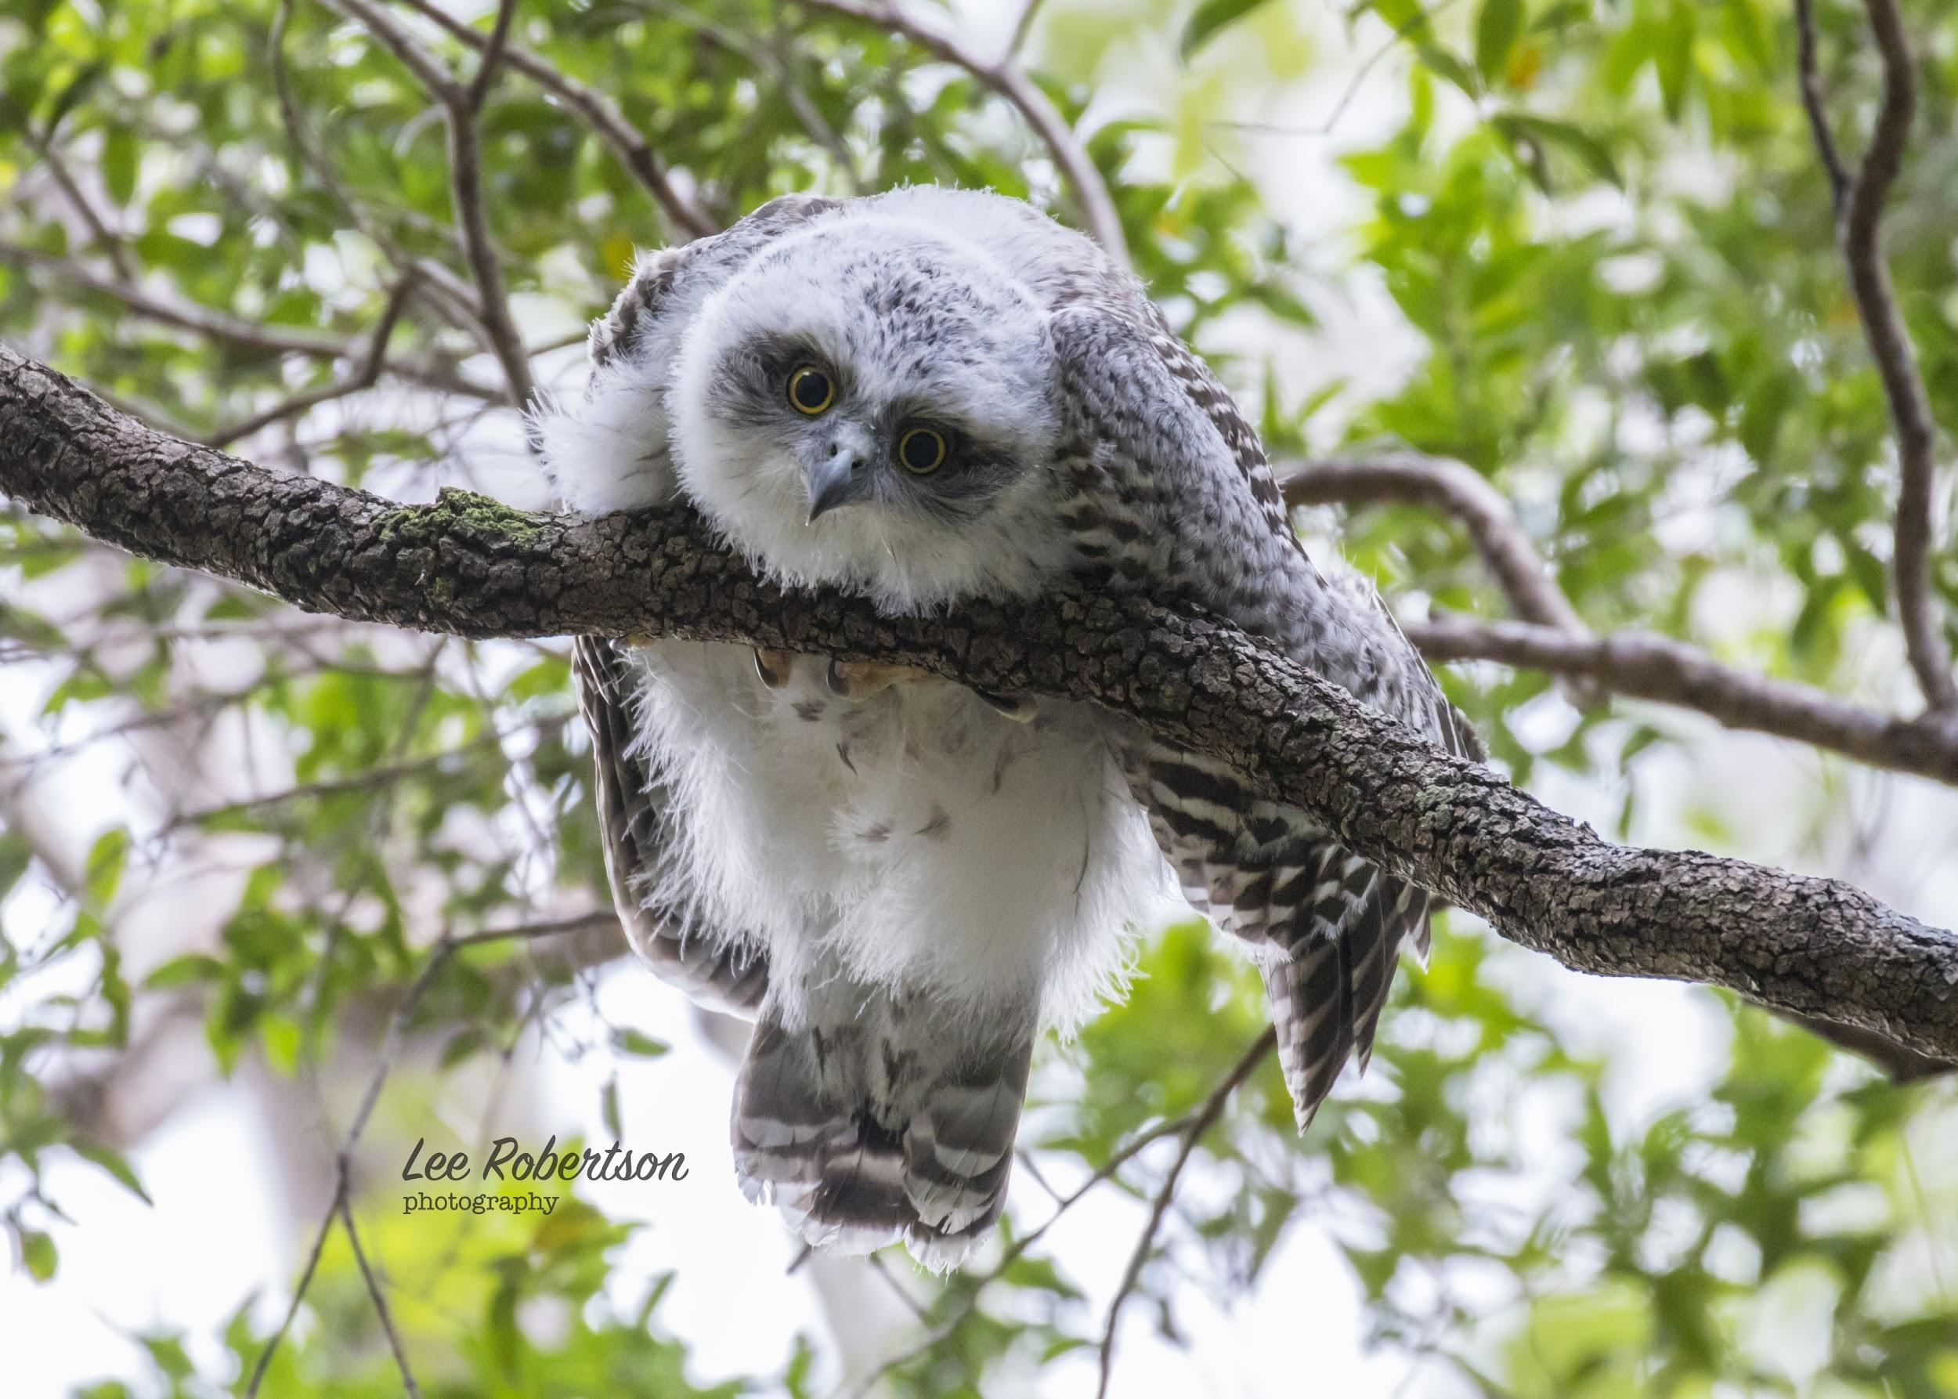
Targeted background or pseudo-absence points & Bias layers
Select background or pseudo-absence points that match the sampling bias
For example,
If building an SDM for Powerful Owl, use pseudo-absence grid cells where other owl species were recorded three times, but a Powerful Owl was not
Proven to help!
Notes:
Each of the algorithms have their own assumptions and limitations with regards to the input data.
As I mentioned earlier, (C) profile models are not able to include categorical predictors or interactions. They generally show poorer performance compared to presence-absence or presence-background models.
(C) Statistical models tend to be more sensitive to outliers and missing data compared to the machine learning models.
(C) But machine learning models are more sensitive to overfitting the data. (C) MaxEnt has an inbuilt process to avoid overfitting.
An advantage of machine learning models, though, is that they (C) are able to handle large datasets. (C) However, if you don’t have many occurrence points available, MaxEnt or a statistical model might work better.
Keep in mind that this guide is not exclusive, and in general it is advised to run multiple models and compare their outcomes.

Slide 9

Step 1: Occurrence data
Set up your environment
Download & filter data
Spatial thinning
Create Bias & targetted background data
Notes:
The EcoCommons is a partnerships program between 9 partner organisations.
We are building: A trusted single platform for ecological and environmental modelling & analysis - our mission is to build the platform of choice for environmental problem solving. The program will run for at least 3 years, so that’s between 2020 and 2023.
As we are building EcoCommons to become a National Research Infrastructure, our vision is to empower Australian practitioners and researchers to use trusted, world-leading ecological and environmental modelling tools.

Slide 10
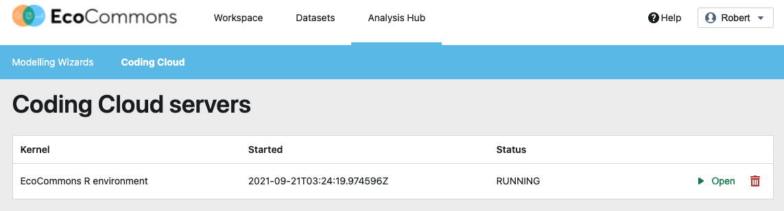
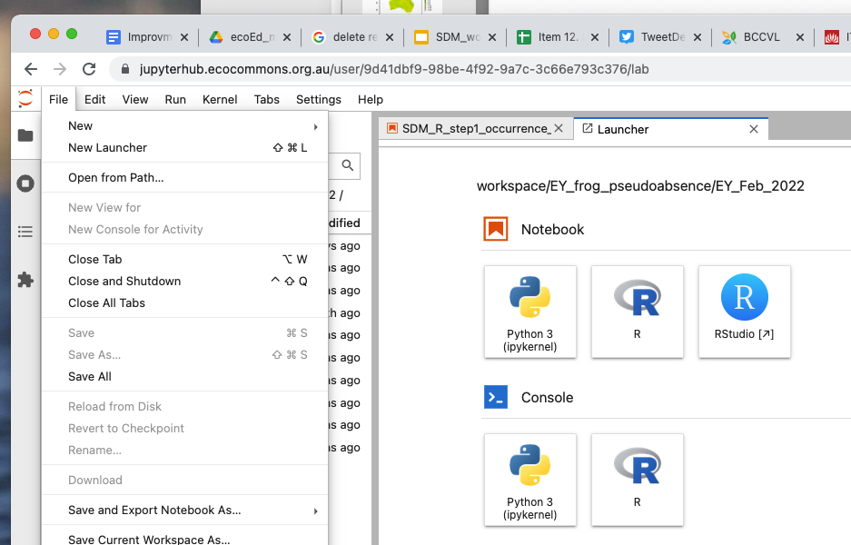
Step 1: Occurrence data
Notes:
The EcoCommons is a partnerships program between 9 partner organisations.
We are building: A trusted single platform for ecological and environmental modelling & analysis - our mission is to build the platform of choice for environmental problem solving. The program will run for at least 3 years, so that’s between 2020 and 2023.
As we are building EcoCommons to become a National Research Infrastructure, our vision is to empower Australian practitioners and researchers to use trusted, world-leading ecological and environmental modelling tools.

Slide 11
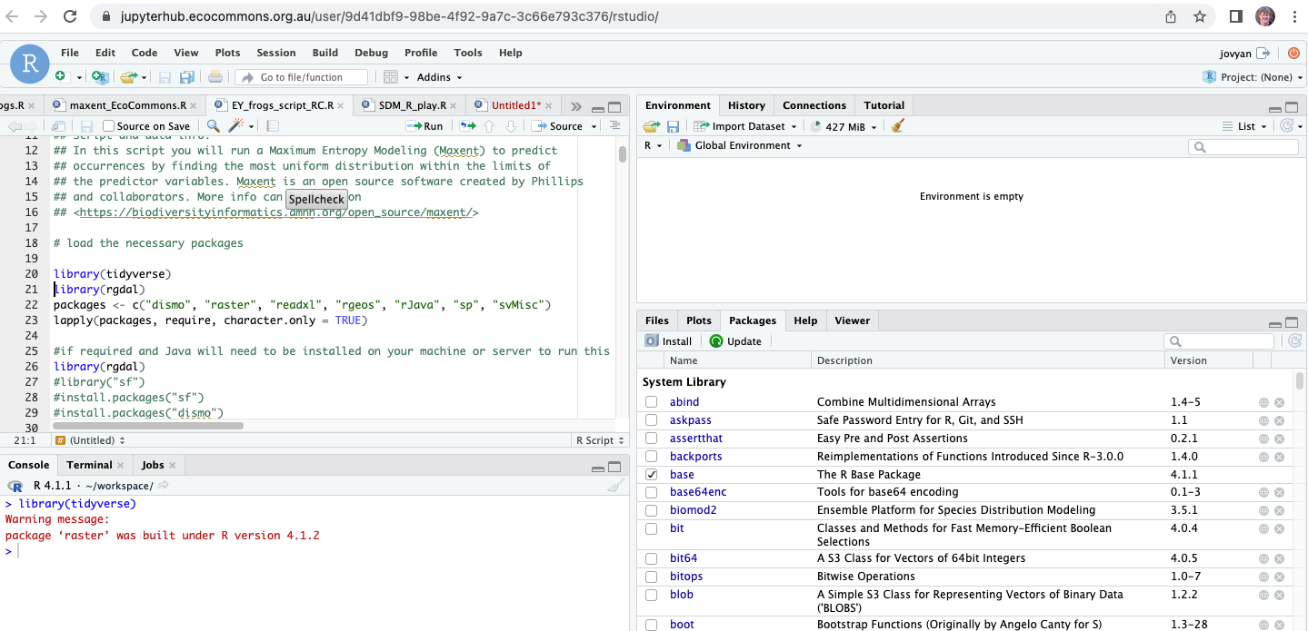
Step 1: Occurrence data - set up your working environment
Need latest version of R installed, packages installed
Maxent is already installed
Java is already installed
Set your directories
direct<- "/Users/s2992269/Documents/Use_cases"
folder <- "/SDM_in_R"
setwd <- paste0(direct,folder)
Notes:
However, if you look up a distribution map of a species, it often shows a range rather than dots on a map. So, how do we go from specific places where individuals of a species have been observed to producing a map that gives an estimate of the distribution of that species? This is where species distribution models come into play.

Slide 12
Step 1: Occurrence data - ALA download & filtering
galah_config(email = "r.clemens@griffith.edu.au")
LiPe <- galah_call() %>%
galah_identify("Limnodynastes peroni")%>%
galah_filter(datasetName == "FrogID")%>%
galah_filter(coordinateUncertaintyInMeters < 100)%>%
galah_select("datasetName")%>%
atlas_occurrences()
write.csv(LiPe, "raw_data/Limnodynastes peroni.csv")
LiPe<-LiPe[,c(2:5)]
https://atlasoflivingaustralia.github.io/galah/articles/quick_start_guide.html
Notes:
However, if you look up a distribution map of a species, it often shows a range rather than dots on a map. So, how do we go from specific places where individuals of a species have been observed to producing a map that gives an estimate of the distribution of that species? This is where species distribution models come into play.

Slide 13
Step 1: Occurrence data - GBIF download & filtering
install.packages("rgbif")
Litoria_fallax_GBIF_raw <- rgbif:: occ_data(scientificName = my_species,
hasCoordinate = TRUE,
limit = 45000)
litoria_fallax <- Litoria_fallax_GBIF_raw$data [ , c("decimalLongitude", "decimalLatitude", "individualCount", "species", "year", "month", "country", "occurrenceStatus","coordinateUncertaintyInMeters", "datasetName", "datasetKey")]
lfallax_tibble <- tibble::as_tibble(litoria_fallax)
lfallax_FrogID <- lfallax_tibble[lfallax_tibble$datasetName == "FrogID",]
lfallax_FrogID2 <- lfallax_FrogID[lfallax_FrogID$coordinateUncertaintyInMeters < 200,]
lfallax_FrogID3 <- lfallax_FrogID2[!is.na(lfallax_FrogID2$datasetName),]
Notes:
However, if you look up a distribution map of a species, it often shows a range rather than dots on a map. So, how do we go from specific places where individuals of a species have been observed to producing a map that gives an estimate of the distribution of that species? This is where species distribution models come into play.

Slide 14
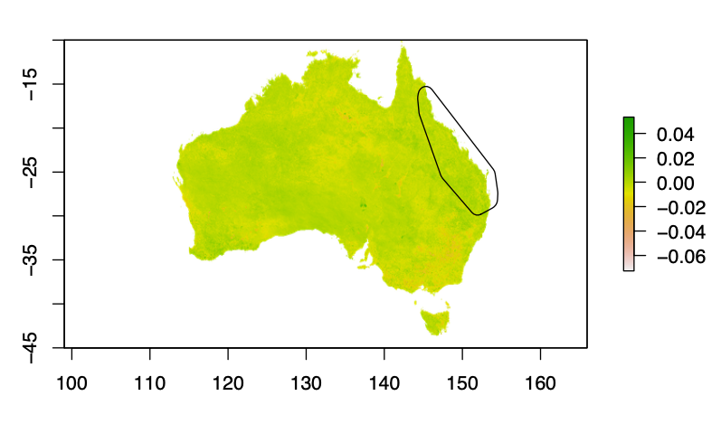
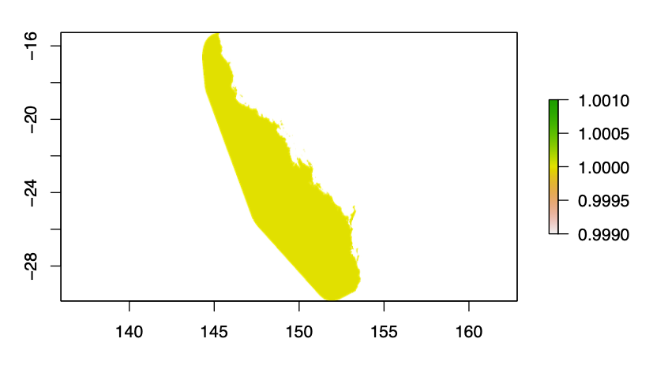
Step 1: Occurrence data - define your study area, make base
EVI<-raster("raw_data/ndlc-2004-250m_trend-evi-mean.tif")
LiPe_pts <- SpatialPoints(coords = cbind(LiPe$decimalLongitude, LiPe$decimalLatitude),CRS(as.character("+proj=longlat +datum=WGS84 +no_defs")) )
LiPe_convH<- rgeos::gConvexHull(LiPe_pts)
LiPe_extent <- rgeos::gBuffer(LiPe_convH, width = 1)
EVI_LiPe<- raster::crop(EVI,LiPe_extent)
EVI_LiPe_mask <- raster::mask(EVI_LiPe,LiPe_extent)
base <- EVI_LiPe_mask/EVI_LiPe_mask
crs(base)<-crs(EVI)
writeRaster(base,"data/base_LiPe.asc", overwrite=TRUE)
Notes:
However, if you look up a distribution map of a species, it often shows a range rather than dots on a map. So, how do we go from specific places where individuals of a species have been observed to producing a map that gives an estimate of the distribution of that species? This is where species distribution models come into play.

Slide 15
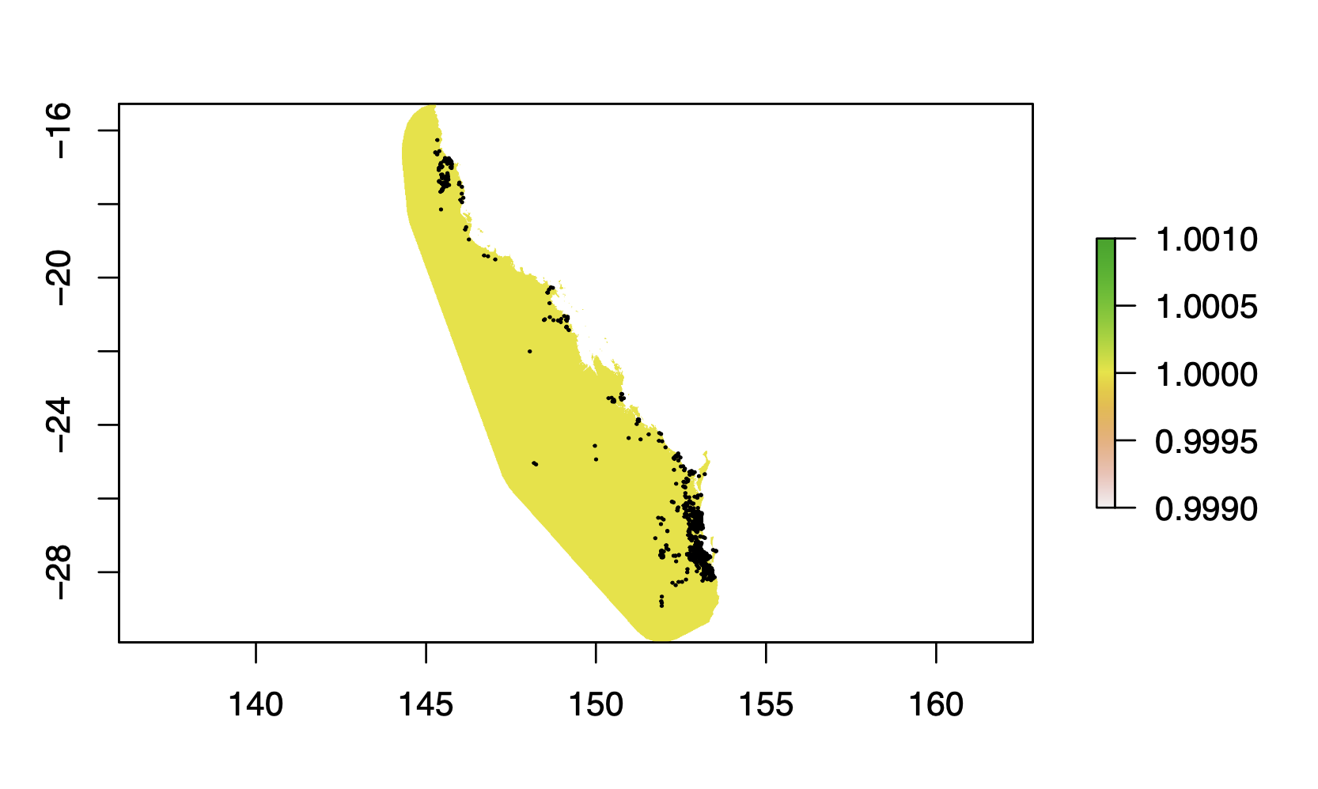
Step 1: Occurrence data - spatial thinning
large_base <- aggregate(base, fact=4)
cell_no<- raster::extract(large_base,LiPe_pts,cellnumbers=TRUE)
LiPe_cells<- cbind(LiPe,cell_no)
require(dplyr)
LiPe_thinned <- LiPe_cells %>%
group_by(cells) %>%
slice_sample(n = 1)
LiPe_pts2 <- SpatialPoints(coords = cbind(LiPe_thinned$decimalLongitude, LiPe_thinned$decimalLatitude),CRS(as.character("+proj=longlat +datum=WGS84 +no_defs")) )
Notes:
However, if you look up a distribution map of a species, it often shows a range rather than dots on a map. So, how do we go from specific places where individuals of a species have been observed to producing a map that gives an estimate of the distribution of that species? This is where species distribution models come into play.

Slide 16
Step 1: Occurrence data - bias layer / targeted background
frogs <- galah_call() %>%
galah_identify("Amphibia")%>%
galah_filter(datasetName == "FrogID")%>%
galah_filter(coordinateUncertaintyInMeters < 100)%>%
galah_select(datasetName,occurrenceID)%>%
atlas_occurrences()
frogs$unique_visit<- paste0(frogs$decimalLatitude,frogs$decimalLongitude,frogs$eventDate)
frogs$visitID <- as.numeric(as.factor(frogs$unique_visit))
frogs2<-frogs[,c(1,3:6,11)]
frogs3 <- frogs2 %>%
group_by(decimalLatitude, decimalLongitude, visitID) %>%
summarise(no_spp = length(unique(scientificName)))
Notes:
However, if you look up a distribution map of a species, it often shows a range rather than dots on a map. So, how do we go from specific places where individuals of a species have been observed to producing a map that gives an estimate of the distribution of that species? This is where species distribution models come into play.

Slide 17
Step 1: Occurrence data - bias layer / targeted background (cont.)
frogs4 <- frogs3 %>%
group_by(decimalLatitude, decimalLongitude) %>%
summarise(no_visits = length(visitID))
visits_pts<-SpatialPoints(coords = cbind(frogs4$decimalLongitude, frogs4$decimalLatitude),CRS(as.character("+proj=longlat +datum=WGS84 +no_defs")))
b1 <- rasterize(visits_pts, base, frogs4$no_visits, fun=sum, background=0)
numb_visits_bias <- b1+base
visit_locations<- raster::extract(b1, visits_pts, cellnumbers=TRUE)
visit_locations2 <- as.data.frame(na.omit(visit_locations))
cellID <- unique(visit_locations2$cells)
xy_visits <- xyFromCell(b1,cell = cellID)
Notes:
However, if you look up a distribution map of a species, it often shows a range rather than dots on a map. So, how do we go from specific places where individuals of a species have been observed to producing a map that gives an estimate of the distribution of that species? This is where species distribution models come into play.

Slide 18
Step 1: Occurrence data - bias layer / targeted background (cont.)
bb <- bbox(b1)
lg<-c(bb[1,1],bb[1,2])
lt<-c(bb[2,1],bb[2,2])
coordss<-cbind(lg,lt)
v_xy2<-rbind(xy_visits,coordss)
For some of these functions kde2d, and xyFromCell I had to increase my local R-environ memory size
Step 1: Open terminal,
Step 2:
cd ~
touch .Renviron
open .Renviron
Step 3: Save the following as the first line of .Renviron:
R_MAX_VSIZE=100Gb
Notes:
However, if you look up a distribution map of a species, it often shows a range rather than dots on a map. So, how do we go from specific places where individuals of a species have been observed to producing a map that gives an estimate of the distribution of that species? This is where species distribution models come into play.

Slide 19
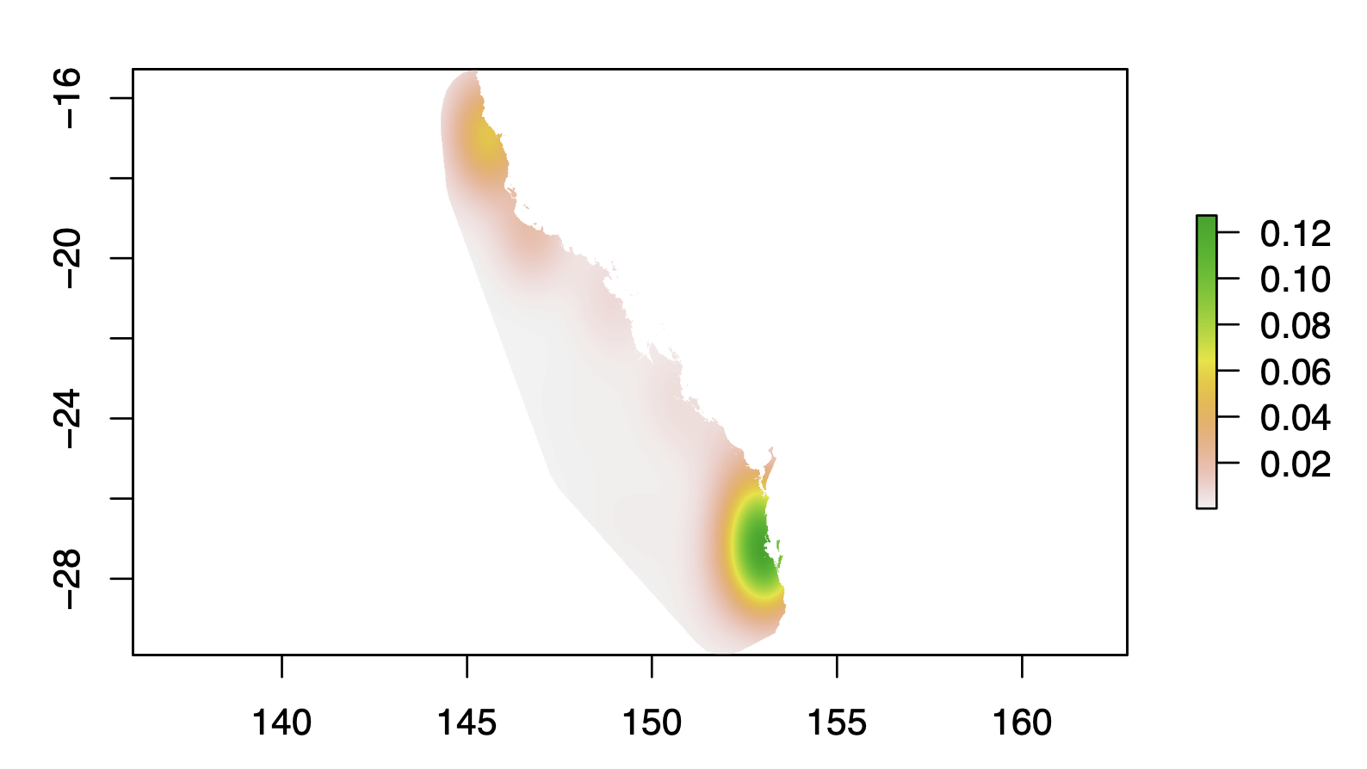
Step 1: Occurrence data - bias layer / targeted background (cont.)
require(MASS)
dens <- kde2d(v_xy2[,1], v_xy2[,2], n = c(nrow(b1), ncol(b1)))
b5 <- raster(dens)
b6<-projectRaster(b5,base)
b7<-mask(b6,base)
bg <- xyFromCell(bias_raster, sample(which(!is.na(values(bias_raster))), 10000, prob=values(bias_raster)[!is.na(values(bias_raster))]))
Notes:
However, if you look up a distribution map of a species, it often shows a range rather than dots on a map. So, how do we go from specific places where individuals of a species have been observed to producing a map that gives an estimate of the distribution of that species? This is where species distribution models come into play.

Slide 20
Step 1: Occurrence data - bias layer / targeted background (cont.)
m <- c(0, 2.9, 0, 2.9, 3247, 1)
reclass <- matrix(m, ncol= 3, byrow= TRUE)
rc <- reclassify(b1, reclass)
visits_3or_more <- mask(rc,base)
freq(visits_3or_more)
LiPe_pres<- rep(1,length(LiPe$decimalLatitude))
LiPe_pres_raster<-rasterize(LiPe_pts,base,LiPe_pres, fun = min, background=0)
LiPe_pres_raster2<-mask(LiPe_pres_raster,base)
freq(LiPe_pres_raster2)
Zero_LiPe <- visits_3or_more - LiPe_pres_raster2
Notes:
However, if you look up a distribution map of a species, it often shows a range rather than dots on a map. So, how do we go from specific places where individuals of a species have been observed to producing a map that gives an estimate of the distribution of that species? This is where species distribution models come into play.

Slide 21
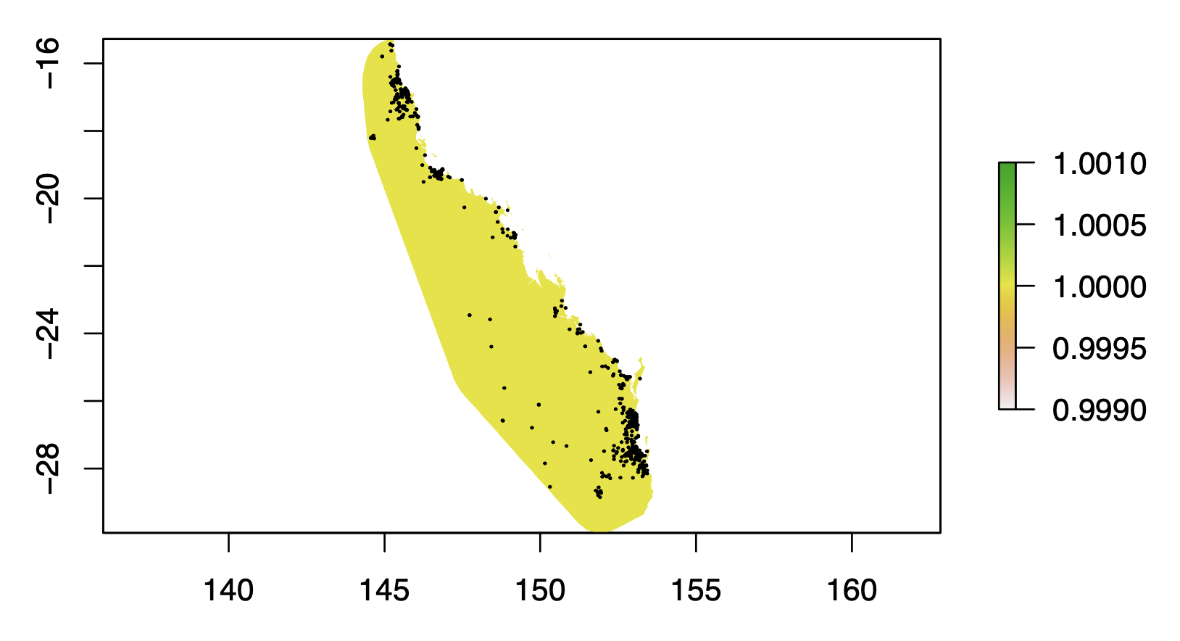
Step 1: Occurrence data - bias layer / targeted background (cont.)
m <- c(-2, 0.1, 0, 0.1, 2, 1)
reclass2 <- matrix(m, ncol= 3, byrow= TRUE)
rc2 <- reclassify(Zero_LiPe, reclass2)
Zero_LiPe2<-mask(rc2,base)
freq(Zero_LiPe2)
cell_vals_0<-Which(Zero_LiPe2 ==1,cells=TRUE)
xy_zero_LiPe <- xyFromCell(Zero_LiPe2,cell = cell_vals_0)
LiPe_zeros<-as.data.frame(xy_zero_LiPe)
colnames(LiPe_zeros)<-c("Long","Lat")
LiPe_zeros$spp<-"Limnodynastes_peroni"
LiPe_zeros$pres<- 0
write.csv(LiPe_zeros,"data/LiPe_zero_locations_3vis.csv")
Notes:
However, if you look up a distribution map of a species, it often shows a range rather than dots on a map. So, how do we go from specific places where individuals of a species have been observed to producing a map that gives an estimate of the distribution of that species? This is where species distribution models come into play.

Slide 22
Predictive performance?
Independent data assessment
Partitioned test data
Cross-validation
Bootstrapping
Training data sensitivity and specificity
Best
Worst

Slide 23

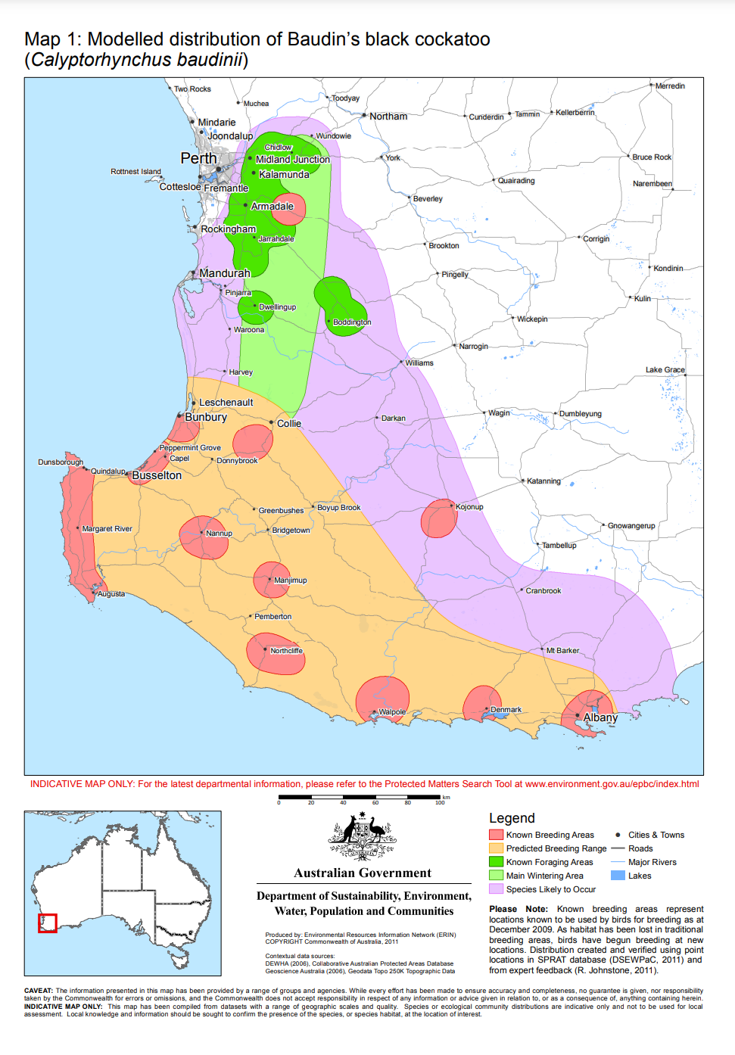
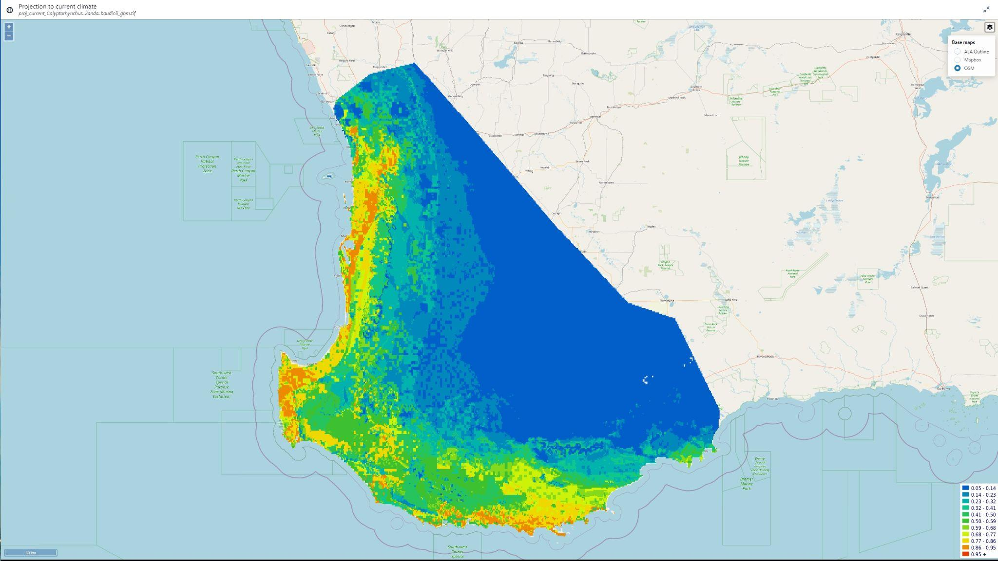
Visualisation of uncertainty
Lots of data from many sources
Coming soon!
Community modelling / GDM
Baudin’s Black Cockatoo (probability of occurrence)

Slide 24

We would welcome your feedback
To learn basics of R coding
https://datacarpentry.org/R-ecology-lesson/
Press feedback button to tell us what changes you want & to highlight anything that is not working.
https://www.ecocommons.org.au/
Use Cases
Educational Material
Notes:
You can find out more about EcoCommons on our webpage: ecocommons.org.au.
To raise awareness of the current extinction crisis, we launched our webpage on Threatened Species Day which remembers the extinction of the Tasmanian tiger (Thylacinus cynocephalus) in 1936. EcoCommons is committed to help researchers and policy-decision makers stop further extinctions by empowering them with data and analytics to do better informed management of Australia’s 1900+ threatened species.
On our webpage you can find out:
How you can become an EcoCommons Pioneer and be the first to explore and test new tools!
Follow our journey - sign up for our newsletter
Follow us on twitter or LinkedIn: @EcoCommonsAus
Collaborate with us!

Slide 25
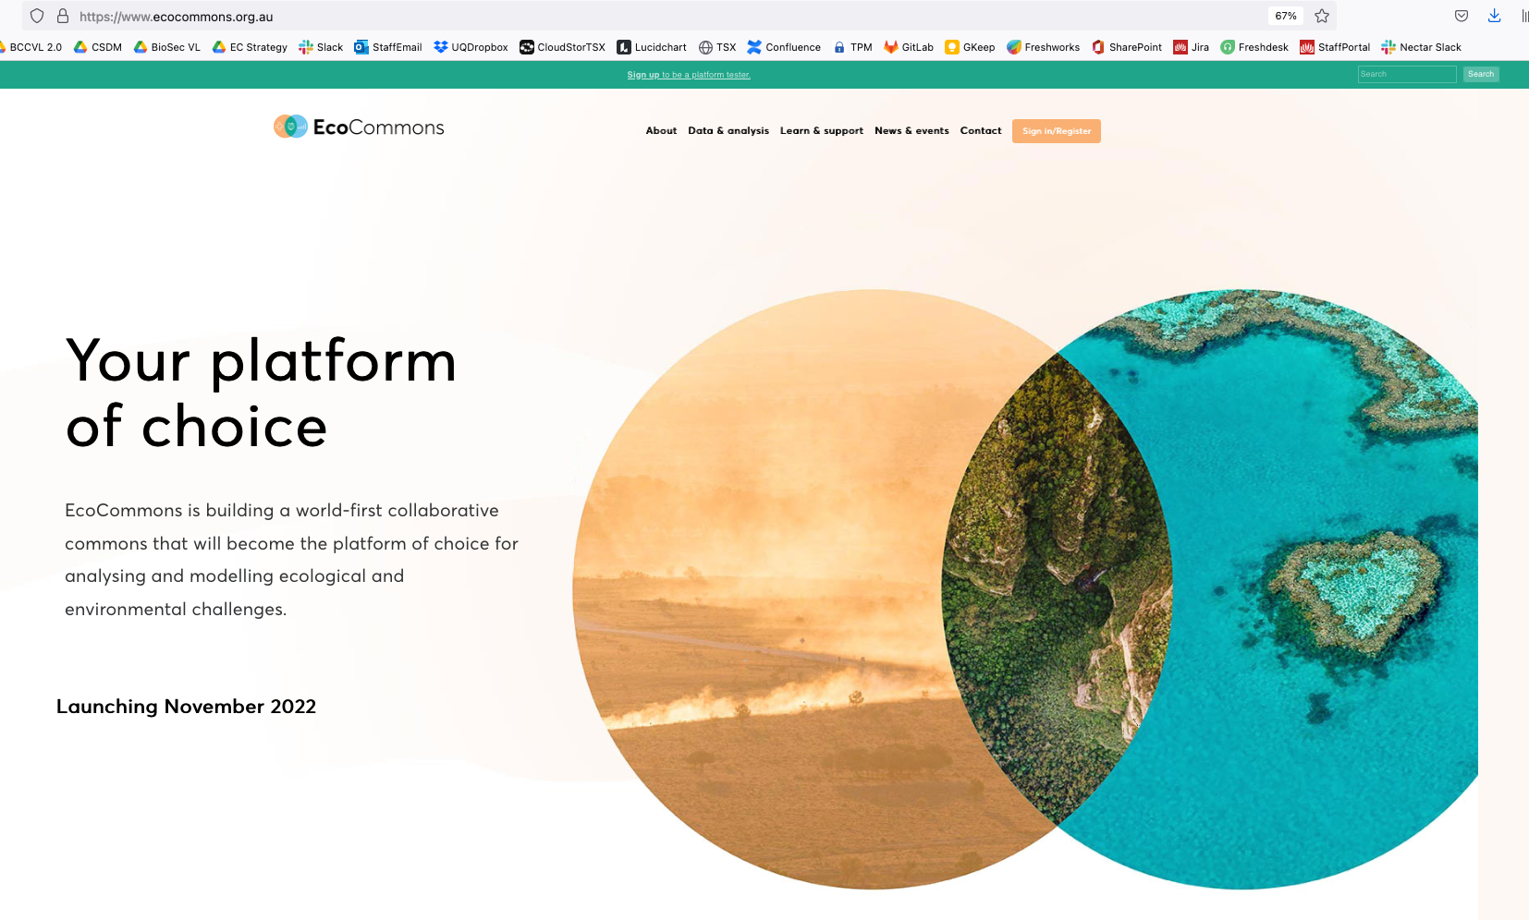
Explore EcoCommons webpage
Follow our Journey
https://www.ecocommons.org.au/
Notes:
You can find out more about EcoCommons on our webpage: ecocommons.org.au.
To raise awareness of the current extinction crisis, we launched our webpage on Threatened Species Day which remembers the extinction of the Tasmanian tiger (Thylacinus cynocephalus) in 1936. EcoCommons is committed to help researchers and policy-decision makers stop further extinctions by empowering them with data and analytics to do better informed management of Australia’s 1900+ threatened species.
On our webpage you can find out:
How you can become an EcoCommons Pioneer and be the first to explore and test new tools!
Follow our journey - sign up for our newsletter
Follow us on twitter or LinkedIn: @EcoCommonsAus
Collaborate with us!

Slide 26


We gratefully acknowledge:

Slide 27


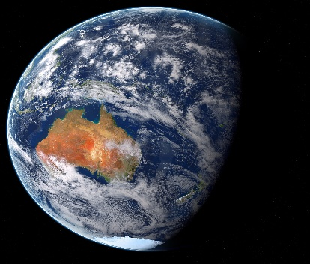
Thank You

